Slide 1
Iris Segmentation Daugman's method
Ieremias Viorel
ivsd1945, gr. 254
16.12.2020

Slide 2
Agenda
01. Introduction
02. Iris for biometry
03. Daugman’s algorithm
04. References
05. Demo

Slide 3
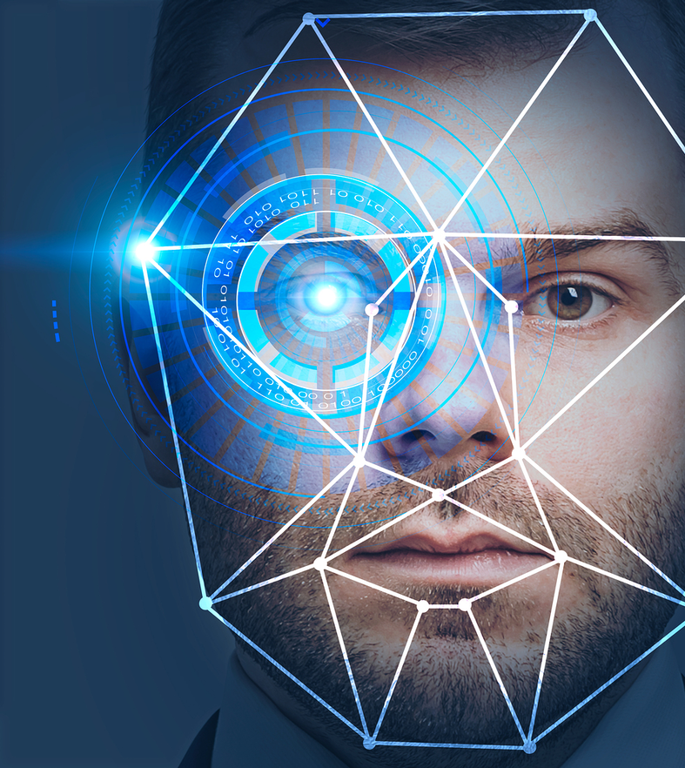
Introduction
How to authenticate a person?
Intro to biometrics
Why use biometrics?
Desired attributes of biometrics
Iris vs other biometrics

Slide 4
How to authenticate a person?
What the individual has?
What the individual knows?
What the individual is/does?
physical token
identification card
badge
ID card
passport
a secret / information
password
PIN
biometric
physiological trait
behavioral trait

Slide 5
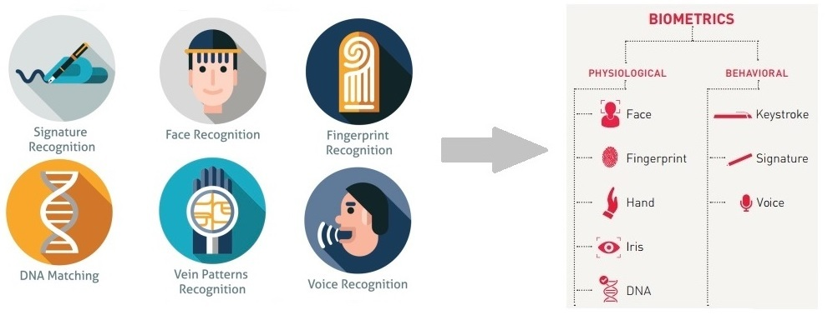
Intro to biometrics

Slide 6
Why use biometrics?
Security
Approach

Slide 7
Desired attributes of biometrics
Universal
Collectible
Every person has the trait
The trait should be reasonably easy check/collect for processing
Unique (distinguishable)
Permanent
The trait should be sufficiently different in two different people
The trait should remain invariable over time

Slide 8
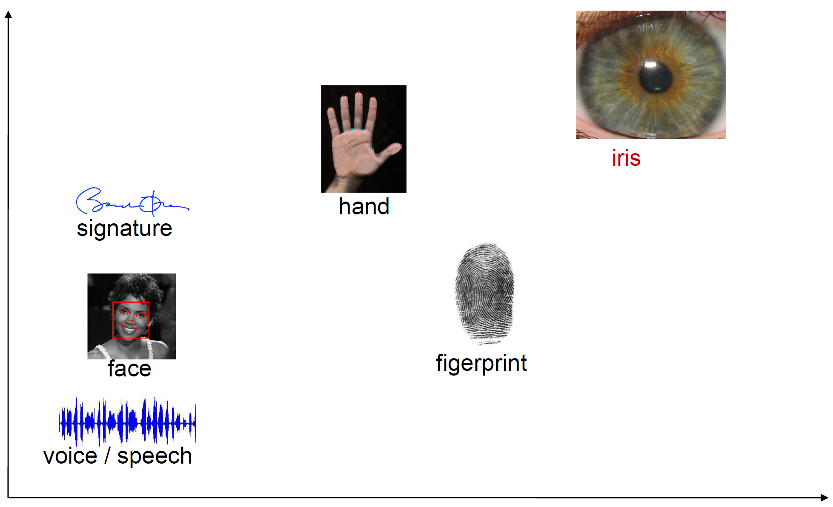
Iris vs other biometrics
Cost
Accuracy

Slide 9
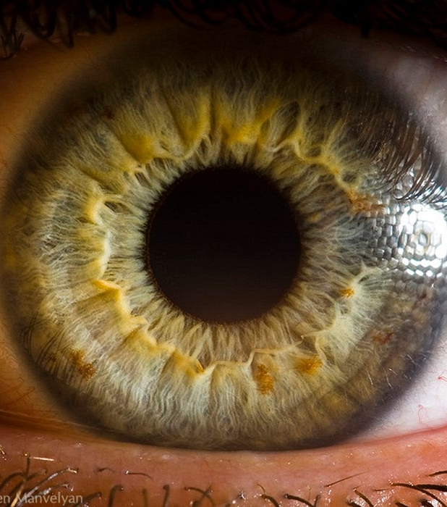
Iris for biometry
Iris characteristics
Uniqueness
Challenges

Slide 10
Iris characteristics
Highly complex, data-rich pattern
Well protected
Unique not only between different people, but different between identical twins and even between the left and right eye of the same person
Internal part of the eye, behind the a transparent window (the cornea)
Invariability
Externally visible
The structure is fixed from about one year in age and remains constant over time (pigmentation can change over time though)
The pattern can be imaged from a distance via noninvasive methods
Genetic independence
Good user acceptability
Iris pattern of children cannot be inferred from data about the parents
Not as intrusive as other biometric identification methods

Slide 11
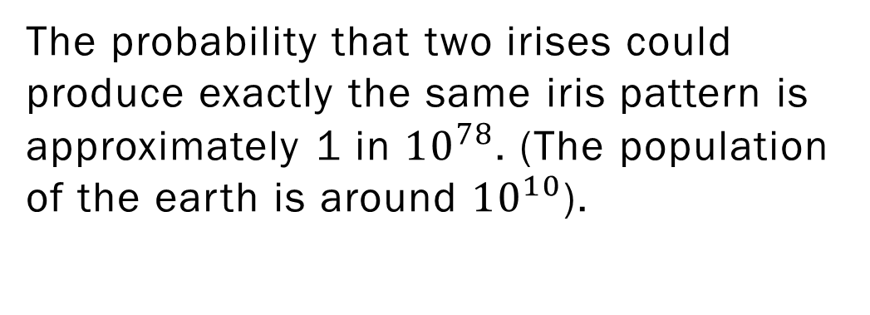
The probability that two irises could produce exactly the same iris pattern is approximately 1 in ${10}^{78}$. (The population of the earth is around ${10}^{10}$).
Frankin Cheung, “Iris Recognition”, BSc thesis, University of Queensland, Australia, 1999

Slide 12
Challenges
Small area to capture
Pose and direction of sight
Approx. 1 cm in size to capture from a distance of about 1 m
Pose can change the part of the iris that is visible to the camera, while the direction of sight can change the part that is hidden under the eyelid
Reflections
Medical conditions
The cornea is a curved, reflecting surface
Some medical conditions can alter the properties of the iris
Obstructions & occlusions
The iris is often partially hidden by eyelashes or behind the eyelids

Slide 13

Daugman’s algorithm
Top-level view
Image acquisition
ROI segmentation
ROI unwrapping
Feature extraction
Feature encoding
Codes comparison

Slide 14
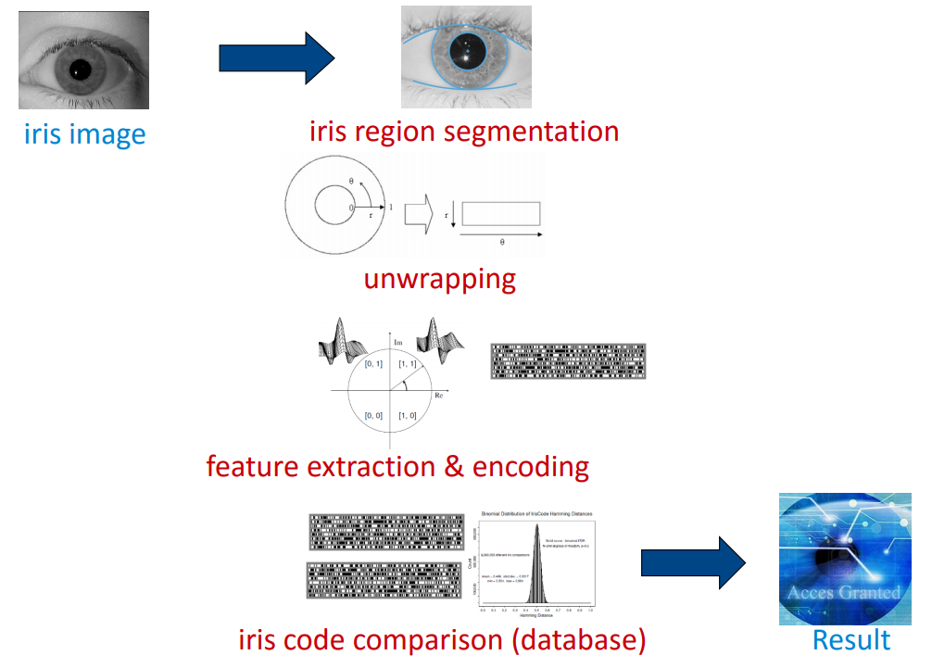
Top-level view

Slide 15
Image acquisition
Usually performed in the near infrared (NIR) spectrum since:
more texture is visible
yields similar results for dark and light eyes
less susceptible to ambient light conditions
less reflections

Slide 16

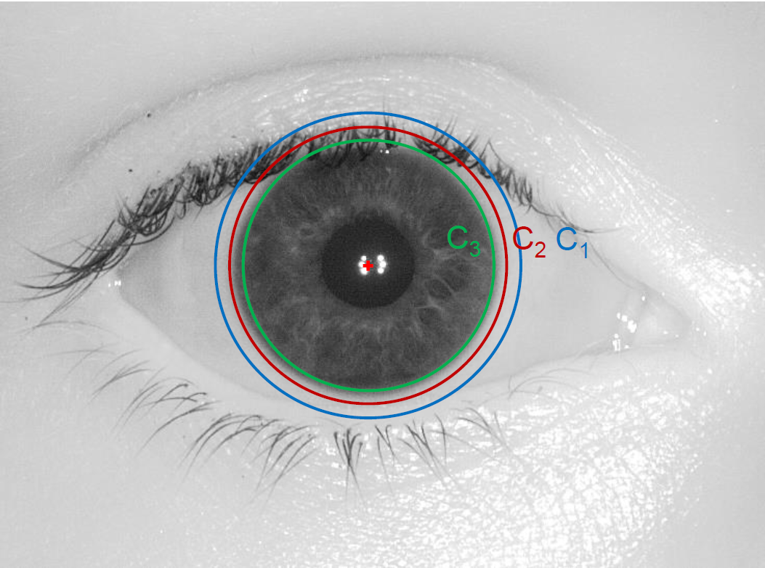
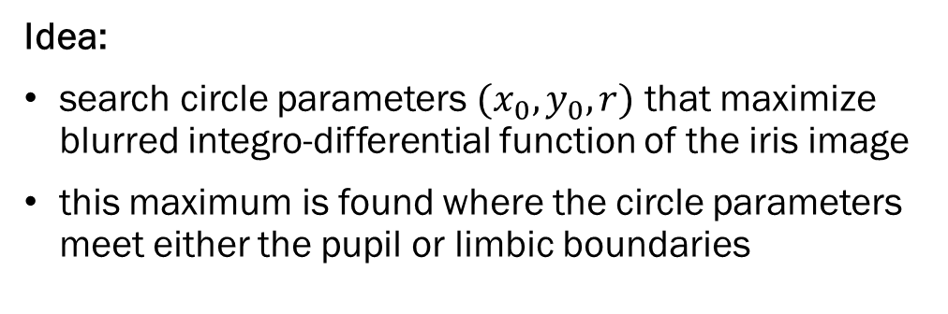
ROI segmentation
Daugman integro-differential operator
$I(x, y)$ - image pixel, $G_{σ}(r)$ – Gaussian smoothing, $\left(r, x_{o }, y_{0}\right)$ - circle radius and center coordinates
Idea:
search circle parameters $(x_{0}, y_{0}, r)$ that maximize blurred integro-differential function of the iris image
this maximum is found where the circle parameters meet either the pupil or limbic boundaries

Slide 17
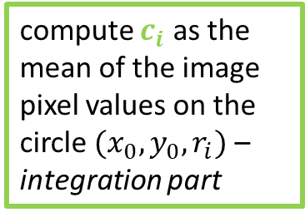
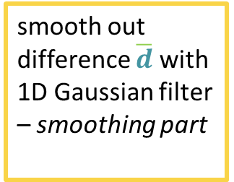
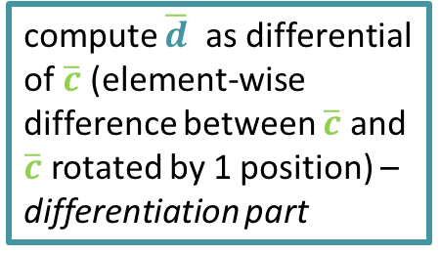
ROI segmentation [2]
compute $c_{i}$ as the mean of the image pixel values on the circle ${(x}_{0}, y_{0}, r_{i})$ – integration part
compute $\overline{d}$ as differential of $\overline{c}$ (element-wise difference between $\overline{c}$ and $\overline{c}$ rotated by 1 position) – differentiation part
smooth out difference $\overline{d}$ with 1D Gaussian filter – smoothing part
find $\left(r, x_{o }, y_{0}\right)$that maximize the smoothed difference

Slide 18
ROI unwrapping
Polar coordinates are mapped to cartesian coordinates
The unwrapped image has constant size, regardless of the segmented iris image
invariance to iris size & distance from camera
invariance to pupil size (determined by lighting conditions)

Slide 19
Feature extraction
Concept – use frequency information
Implementation – Gabor wavelets
Frequency information is more relevant than amplitude information in an iris image because:
amplitude is subject to illumination, reflections, and pigmentation, unlike frequence
frequency captures the textures in the image
iris texture is unique, but pigmentation is subject to change
use the frequency information in the iris image
used for texture analysis
cosine-sine wave quadrature pairs whose attributes are modulated by a Gaussian function
parameterized with size, orientation, and x and y coordinates
it is believed that the visual cortex of mammals can be modeled by Gabor functions

Slide 20
Feature extraction [2]
Even symmetric component
Cosine wave
Odd symmetric component
Sine wave

Slide 21
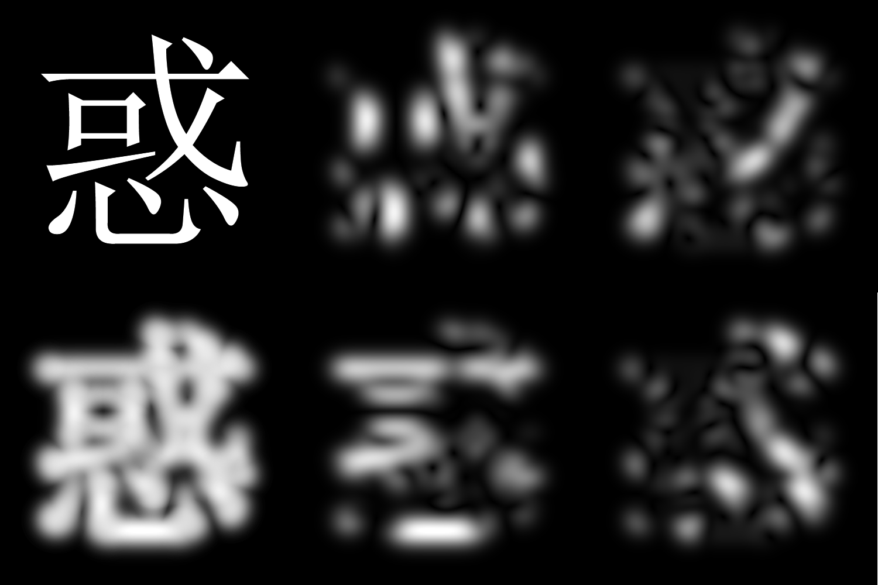
Original
90°
45°
Rebuilt
0°
135°

Slide 22
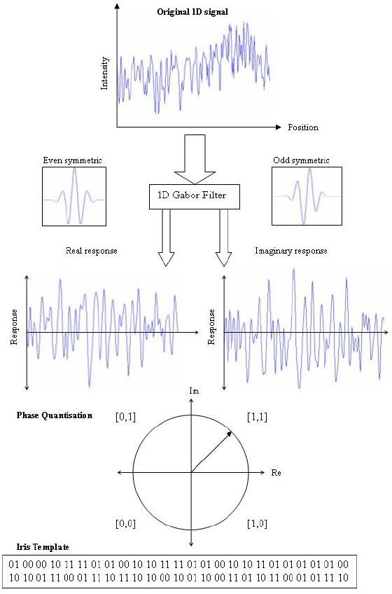
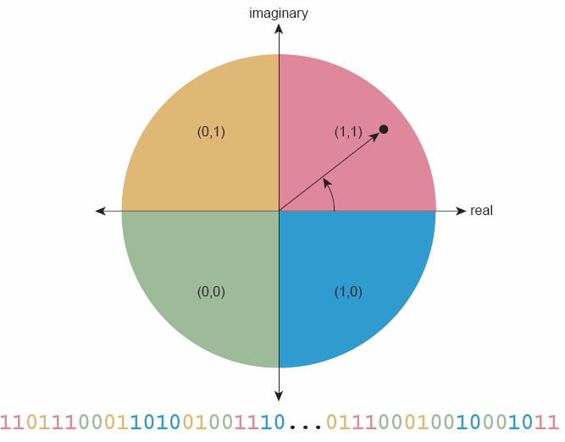
Feature encoding

Slide 23
Codes comparison
Hamming distance
Shifting process
determines the number of different bits in two vectors
sequence of XOR operations
e.g. 1001011 and 1100011, H=2
normal Hamming distance outputs a large distance for iris codes of the same eye if the images are taken at different rotation angles
compute multiple Hamming distances by shifting one of the code by 2 bits at a time and consider the minimum distance
the model gain rotation invariance (iris size and pupil size invariance solved during unwrapping)

Slide 24
References
Daugman J (2007) "New methods in iris recognition." IEEE Trans. Systems, Man, Cybernetics B 37(5), pp 1167-1175
Daugman J (2000) "Biometric decision landscapes." Technical Report No. TR482, University of Cambridge Computer Laboratory
A Phase-Based Iris Recognition Algorithm - Kazuyuki Miyazawa, Koichi Ito, Takafumi Aoki, Koji Kobayashi and Hiroshi Nakajima
IRIS recognition - Eduard Bakštein
Iris Recognition Based on Multichannel Gabor Filtering - Li Ma, Yunhong Wang, Tieniu Tan

Slide 25

Demo

